Slide 1
Trade war: latest developments in the EU-US trade relationship
Erasmus University Rotterdam, 12 September 2025
Dr. Martijn Schippers

Slide 2
Agenda
Trip down memory lane
Liberation day
EU-US Trade Framework Agreement
Proposals to remove tariffs on US goods
Federal Court case

Slide 3
1. Trip down memory lane
Multipolar system
Geopolitical conflict
Focus on security
Inflection
Post-Cold War era of globalization
New era of globalization
Unipolar system
Geopolitical cooperation
Focus on economics
2008–2019

Slide 4
1. Trip down memory lane
Trump trade messaging timeline
2016 Campaign
2017-2021 Presidency
2020 Campaign
2024 Campaign
Promised to reduce the US trade deficits with other countries and bring home manufacturing
Rallied against previous trade deals on the basis that they hollowed out American manufacturing
Withdrew from the Trans-Pacific Partnership
Renegotiated NAFTA into the USMCA with provisions to increase manufacturing
Increased tariffs on imports on all countries, particularly on steel and aluminum
Increased broader trade restrictions on China, mostly on industrial goods
Continuation of protectionist trade rhetoric
Argued that his trade policy helped domestic manufacturing
Touted the Phase One trade deal with China as a success
Campaigned against the World Trade Organization
Promised a 10% across-the-board tariff on imports from all countries
Promised a 60% tariff on all imports from China
Floated a potential withdrawal from the World Trade Organization
Source: Teneo Insights; NPR; Internal analysis

Slide 5
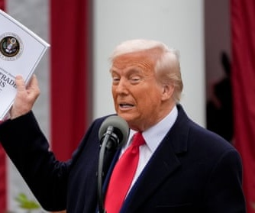
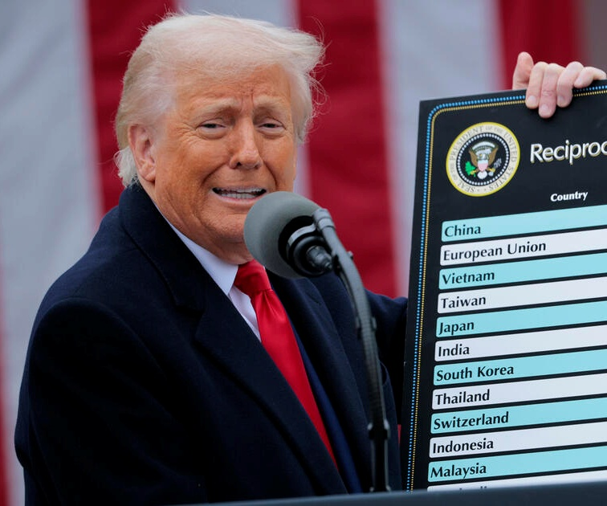
2. Liberation day

Slide 6
2. Liberation day
Base line tariff of 10%
(5 April 2025)
Country-specific ad valorem right of 20% for EU originating goods
(9 April 2025)

Slide 7
2. Liberation day
Three step approach in terms of counter reactions
1. Reinstate commercial policy measures that were adopted in 2018, during Donald Trump's first administration, and had been suspended since 2022. These measures will take effect again as of 15 April 2025 and will target imports of certain products originating from the United States. The targeted products include bourbon, certain textile products, specific steel and aluminum products, motorbikes and boats. It is important to note that Annex II to the EU's 2018 countermeasures will also become applicable for the first time — the annex had not been implemented prior to the 2022 suspension.

Slide 8
2. Liberation day
Three step approach in terms of counter reactions
2. The EU has published a nearly 100-page document listing tariff codes that could be subject to new additional tariffs. The value of the targeted imports totals approximately €18b, encompassing a wide variety of both industrial and agricultural products. This list has served as the basis for a consultation process running until 26 March 2025. Based on the input received from stakeholders, the European Commission is preparing an implementing regulation to be adopted following a consultation process with the various EU Member States. The European Commission anticipates that the new measures will ultimately enter into force in mid-April.
3. In addition to the three-step approach, the EU will further prepare for countermeasures if negotiations fail.

Slide 9
2. Liberation day
8 April 2025: the country specific ad valorem rights (excl. China) are suspended for 90 days.

Slide 10
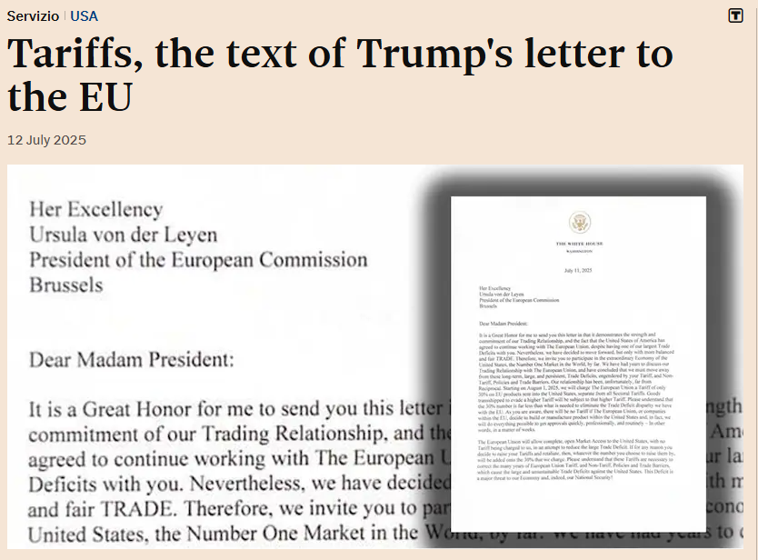
2. Liberation day

Slide 11
3. EU-US Framework Agreement
EU to eliminate tariffs on all US industrial goods, and preferential treatment US seafood and agricultural goods
US to impose flat-rate of 15% on EU originating goods unless MFN is higher
MFN rate on EU originating unavailable natural resources (including cork), all aircraft and aircraft parts, generic pharmaceuticals and their ingredients and chemical precursors.
Despite outcome 232 section investigations on pharmaceuticals, semiconductors, and lumber: US tariff does not exceed 15%.
US import rate to 15% for cars as of 1st of the month that EU publish proposal to eliminate tariffs
Further simplification/flexibilities for CBAM and other sustainability measures

Slide 12
3. EU-US Framework Agreement
Reactions European Parliament
Complaints about the investments the EU committed itself to (i.e., 750 billion dollars in US gas, oil and nuclear power)
Doubts about stability – 400 additional steel products subject to higher duties, treat of Trump to impose additional duties as a result of the penalty to Google
Ask for the use of the anti-coercion instrument
Ask to speed up negotiations of trade deals with other countries than US

Slide 13
4. Proposals to remove tariffs on US goods
Two proposals
Proposal for a REGULATI OF THE EUROPEAN PARLIAMENT AND OF THE COUNCIL on the non-application of customs duties on imports of certain goods (‘Lobster regulation’)
Proposal for a REGULATION OF THE EUROPEAN PARLIAMENT AND OF THE COUNCIL on the adjustment of customs duties on the import of certain goods originating in the United States of America and opening of tariff quotas for imports of certain goods originating in the United States of America

Slide 14
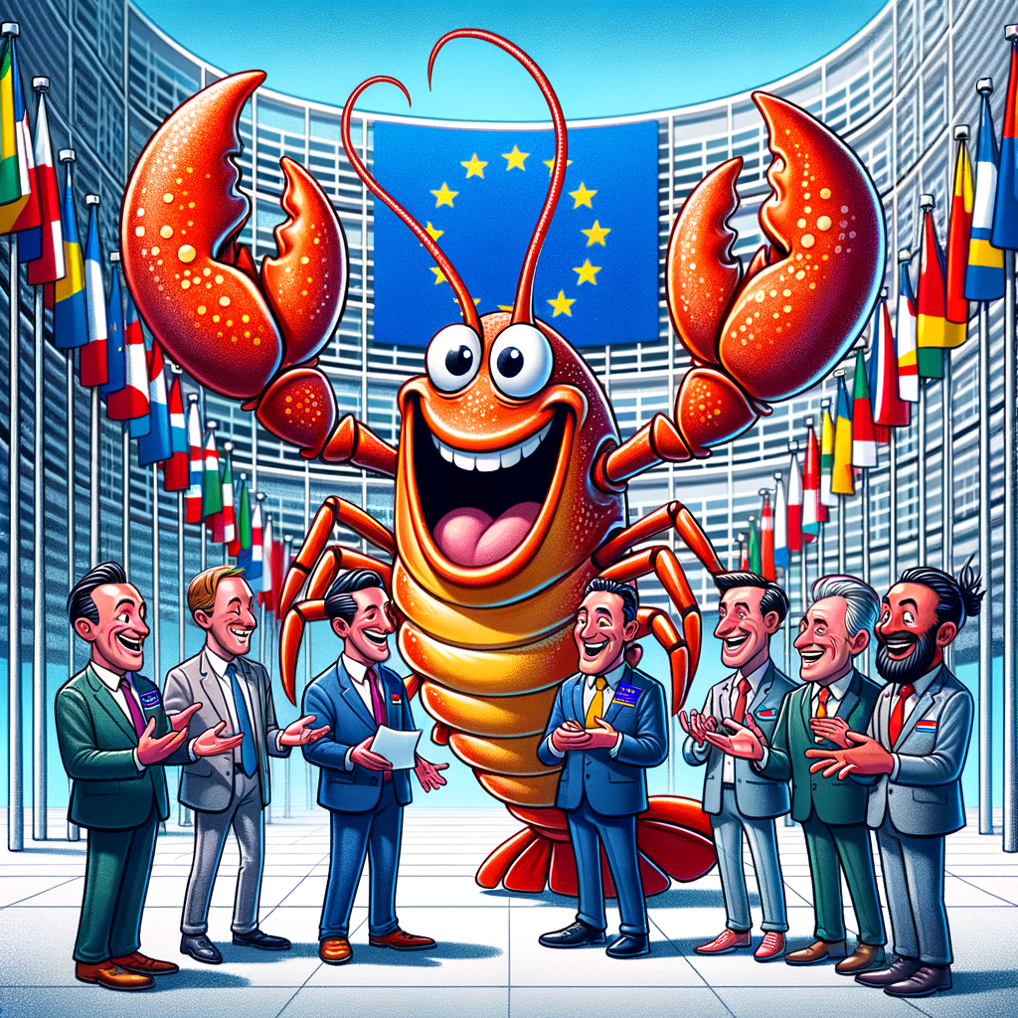
4. Proposals to remove tariffs on US goods
Characteristics of the ‘lobster regulation’
Retroactive effect as of 1 August
Reimbursement possible
Irrespective of the origin

Slide 15
4. Proposals to remove tariffs on US goods
Characteristics of the regulation to remove tariffs on US goods
No retroactive effect
General legislative process
Non-preferential origin, until preferential origin rules are establised
Three annexes
Annex 1 – removal of tariffs
Annex 2 – removal of ad valorem duties only
Annex 3 – tariffs quota

Slide 16
5. Federal Court case
The Trump Administration last week appealed to the US Supreme Court the 29 August US Court of Appeals for the Federal Circuit en banc opinion that said President Trump exceeded his authority with respect to his tariff policy. The Federal Circuit affirmed (7-4) a decision by the US Court of International Trade (CIT) that held that President Trump had exceeded his authority in imposing certain tariffs under the International Emergency Economic Powers Act (IEEPA). The Federal Circuit had temporarily stayed the CIT’s decision, allowing the IEEPA-based tariffs to remain in place pending appeal.

Slide 17
5. Federal Court case
The Federal Circuit panel ultimately agreed with the lower court that “IEEPA’s grant of presidential authority to ‘regulate’ imports does not authorize the tariffs imposed by [five Presidential] Executive Orders,” which included the 2 April "Liberation Day" announcements and Executive Orders imposing tariffs on Mexico, Canada and China in response to migration and drug smuggling allegations. The Supreme Court’s affirming the Federal Circuit’s decision against the Administration’s actions would be a major blow to President Trump’s tariff policy and could result in billions of dollars in tariff refunds.

Slide 18
Thank you for your attention!
Dr. Martijn Schippers
schippers@law.eur.nl

